Slide 1
Wow Technical Deliverable(4th Tech Talk)
Platform: Market Area North America (MANA) Platform
Topic: Securing Connection of Jupyterhub by Implementing HTTPS
Date of Presenting: 3rd September 2019
Presenter: Sanjoy Sen (ESESANJ)

Slide 2
Problem Statement
“Presently we are connecting to Jupyterhub webpage through http connection which is vulnerable. To make it secure, SSL implementation is required.”
Reference of the ticket: https://wcdma-jira.rnd.ki.sw.ericsson.se/browse/MC-487
“Since JupyterHub includes authentication and allows arbitrary code execution, you should not run it without SSL (HTTPS).”

Slide 3
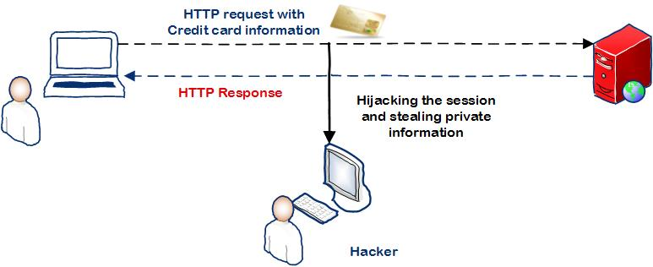
Solution Delivered/Implemented
Enabling SSL encryption
Generating SSL certficate.
SSL Certificate from a trusted SSL provider.
self-signed certificate
Specifying key and certificate in the jupyterhub_config.py configuration file.

Slide 4
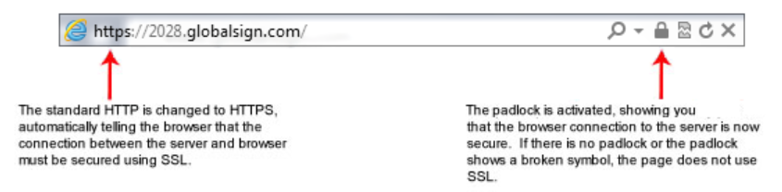
Implementation Steps
Generating SSL certficate
What is an SSL Certificate:
SSL Certificates are small data files that digitally bind a cryptographic key to an organization’s details.
Purpose:
An organization needs to install the SSL Certificate onto its web server to initiate a secure session with browsers.
When installed on a web server, it activates the padlock and the https protocol and allows secure connections from a web server to a browser.

Slide 5
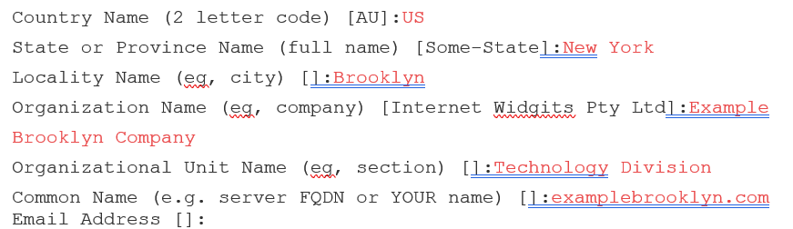
Certificate Signing Requests (CSRs) First steps towards getting your own SSL Certificate Generated on the same server you plan to install the certificate on The CSR contains information (e.g. common name, organization, country) about your business and the website you’re trying to equip with SSL. It also contains the public key that will be included in your certificate and is signed with the corresponding private key.

Slide 6
Generate a Self-Signed Certificate
To generate a pair of private key and Certificate Signing Request (CSR) for a webserver, use the following command :
openssl req -x509 -nodes -newkey rsa:2048 -keyout myserver.key -out server.csr -days 365
-x509 option tells req to create a self-signed certificate. this option outputs a self signed certificate instead of a certificate request.
The -days 365 option specifies that the certificate will be valid for 365 days.
The req command primarily creates and processes certificate requests
-newkey arg this option creates a new certificate request and a new private key.
-keyout filename this gives the filename to write the newly created private key to. If this option is not specified then the filename present in the configuration file is used.
-out filename : This specifies the output filename to write to or standard output by default.
-nodes without using a passphrase.

Slide 7
View Certificate Entries
This command allows you to view the contents of a certificate (domain.crt) in plain text:
openssl x509 -text -noout -in server.csr

Slide 8
Enabling SSL encryption
Once we have obtained and installed a key and certificate, we need to specify their locations in the jupyterhub_config.py configuration file as follows:
c.JupyterHub.ssl_key = '/path/to/my.key'
c.JupyterHub.ssl_cert = '/path/to/my.cert'

Slide 9
Ericsson Certificate Services Portal
Ericsson Certificate Services provides server administrators, webmasters, programmers and other Ericsson representatives (including HP and IBM) with a way to obtain certificates for servers (SSL) and for code sigining.
The process requires you to provide your name, e-mail adress, and your manager or a group mailbox you belong to (in case you will not be reached when the certificate expires). You will also need to provide a CSR (Certificate Signing Request) generated from your server. Both your name and e-mail together with the CSR will be validated before the order is completed
Link :https://ecs.internal.ericsson.com/CertificateServices/Home
User Guide Training: https://itsc.internal.ericsson.com/product/LXA116497#userguides-training

Slide 10
Thank You

